Slide 1

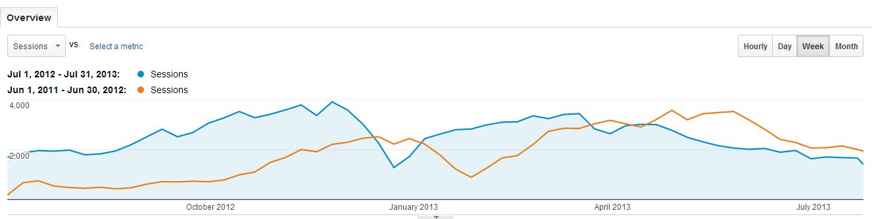
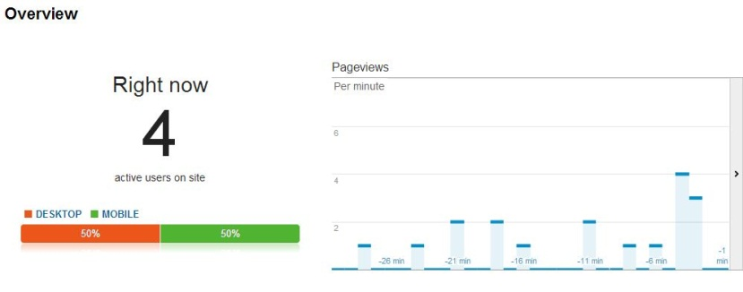
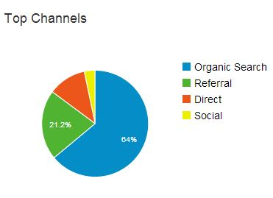
Using Google Analytics Data to Expand Discovery and Use of Digital Archival Content
Society of American Archivists 2014 Annual Meeting
Michael Szajewski, Archivist for Digital Development and University Records,
Ball State University Libraries
Ball State University Libraries
A destination for research, learning, and friends

Slide 2
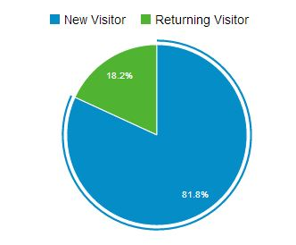
Google Analytics and Unhiding Your Collections
What is Google Analytics?
  A free widely-used Google-powered tool for web use analysis that provides statistical reports regarding the use of a web site.
Why use Google Analytics?
  Informed decision-making
  Justification for supporting digital initiatives
Google Analytics can provide data about:
  Content
  Users
  Methods of access and discovery
  And any combination of these factors
Ball State University Libraries
A destination for research, learning, and friends

Slide 3
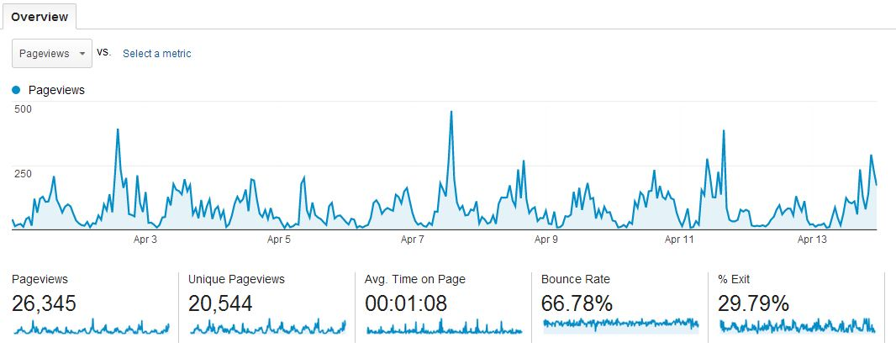
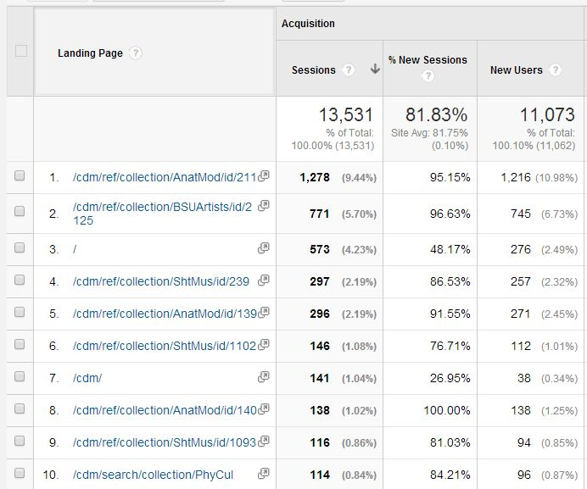
Content Data
Individual asset use data
Asset group use data
Landing page data
Change in these figures over time
Ball State University Libraries
A destination for research, learning, and friends

Slide 4
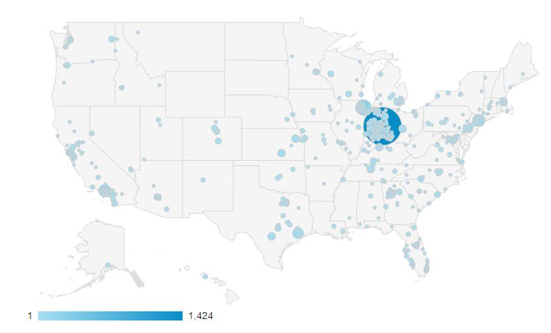
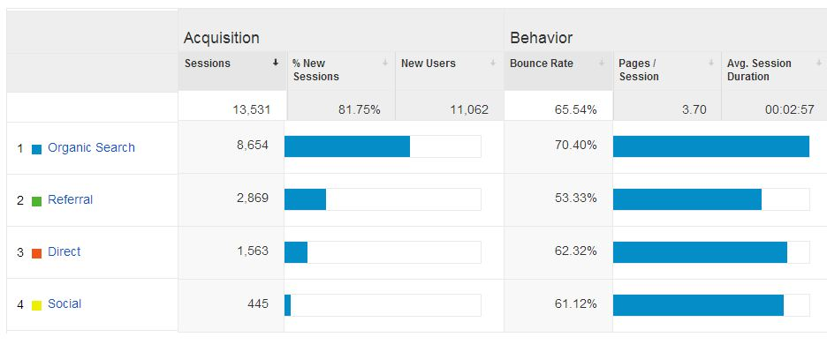
User Data
Quantitative use data
User type data
Engagement data
Technology data
Ball State University Libraries
A destination for research, learning, and friends

Slide 5
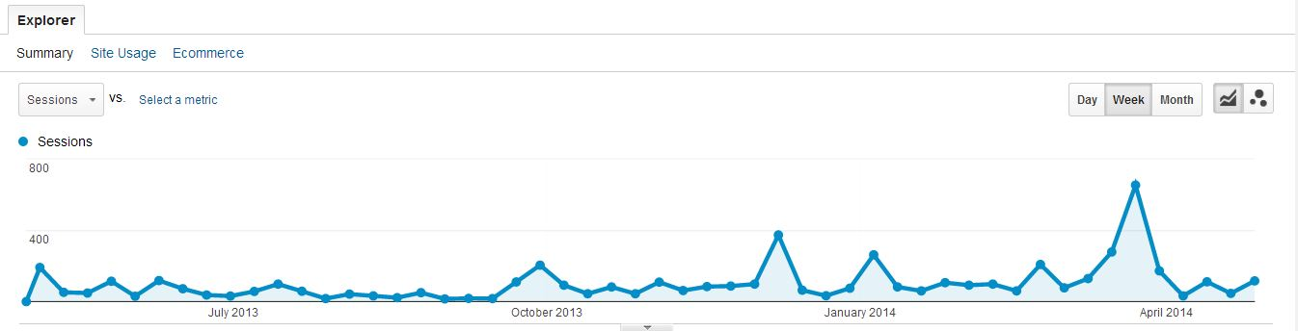
Access Data
General access data
Keyword Search data
Outreach campaign evaluation
Ball State University Libraries
A destination for research, learning, and friends

Slide 6
Combining Metrics for In-Depth Analysis
Which content has the most local appeal? Which content has the most global appeal?
Which methods of promotion best helped cultivate a stronger local user base? Which helped best cultivate a global user base?
Which combinations of hardware/software have particularly short average visit times?
Which content was most popular when shared via social media?
Which content was of most interest to Google searchers?
Which content was most popular for users of local library catalogs and databases?
At a collection-by-collection level, how did metadata provided affect resource discovery?
Ball State University Libraries
A destination for research, learning, and friends

Slide 7
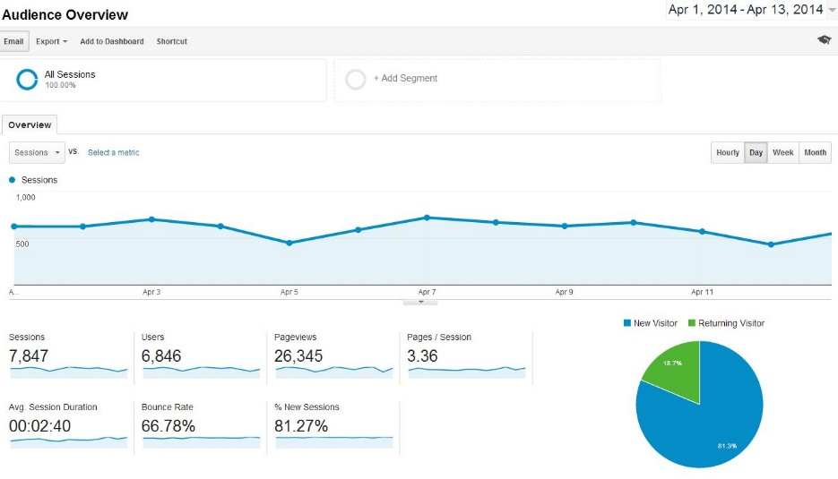
In Conclusion
Informed decision-making
Justification for supporting digital initiatives
For more information: Szajewski, Michael. “Using Google Analytics Data to Expand Discovery and Use of Digital Archival Content”. Practical Technology for Archives, November 2013. http://practicaltechnologyforarchives.org/issue1_szajewski/
Ball State University Libraries
A destination for research, learning, and friends

